Slide 1
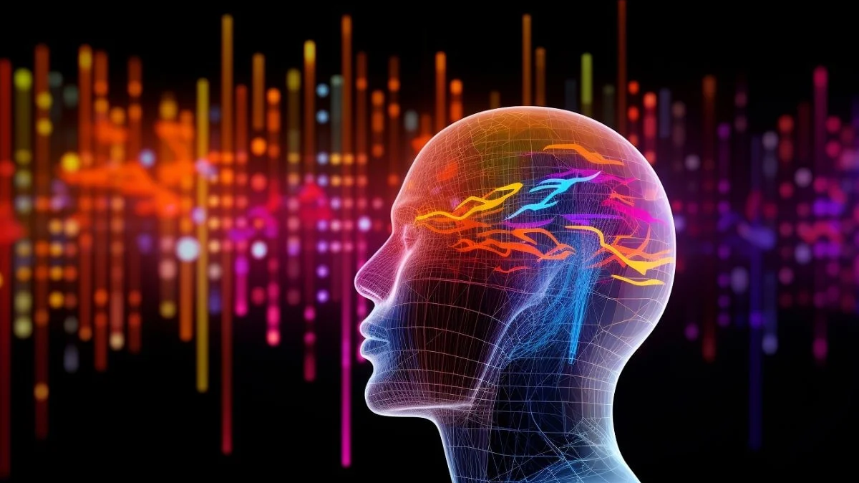
ARTIFICIAL INTELLIGENCE IN SPEECH IMPAIRMENT
AIMAN ALAM
30006688
ARTIFICIAL INTELLIGENCE IN BUSINESS AND SOCIETY

Slide 2

CONTENTS
What is Speech Impairment?
Types and Causes
Why is it important to consider this as a major concern?
How can AI help them?
Technologies
Devices
Conclusion
References

Slide 3


WHAT IS SPEECH IMPAIRMENT ?
Speech impairment, also known as a speech disorder or communication disorder, refers to any condition that affects an individual's ability to produce sounds accurately, fluently, or coherently while speaking. Speech impairments can manifest in various ways and can include difficulties with articulation (pronouncing sounds and words), voice quality, fluency, and overall.

Slide 4
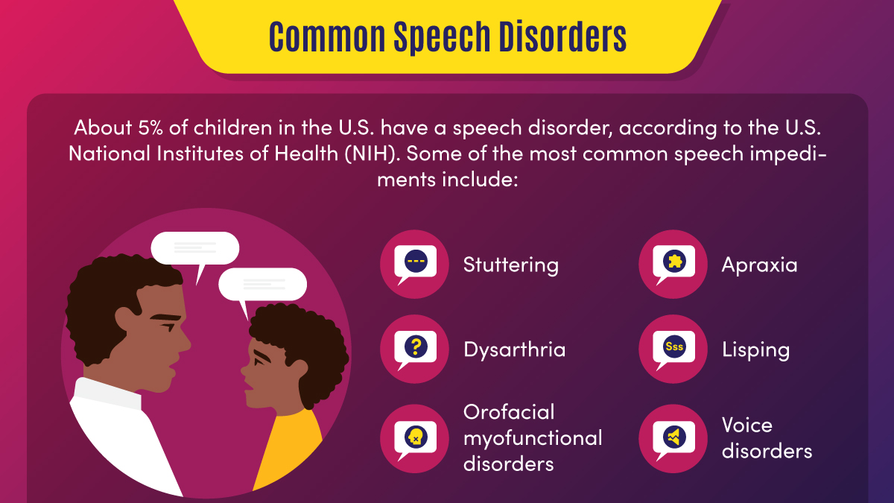

Slide 5

OTHER CAUSES
Cerebral Palsy
Stroke
Traumatic Brain Injury (TBI)
Hearing Loss
Psychological or Emotional Factors

Slide 6

WHY IS IT IMPORTANT TO CONSIDER THIS AS A MAJOR CONCERN?
Approximately 18.5 million individuals have a speech, voice, or language disorder.
About 10% of the world's population is affected by communication disorders.
Nearly 40% of children with speech and language disorders have a behavioral or emotional disorder.
About 25-40% of children with speech and language disorders also have a reading disability.
Annual diagnoses increased 29% in 2021 and an additional 81% in 2022, respectively, compared to the pre-pandemic average.

Slide 7

HOW AI CAN HELP THESE PEOPLE ?
Easing Communication
2. Learning Opportunities
3. Promoting An Independent Lifestyle
4. Connection To The Outside World

Slide 8

TECHNOLOGIES
AAC Devices (Augmentative and Alternative Communication)
Eye-Tracking Communication Systems
Brain-Computer Interfaces (BCIs) for Communication
Sound-Generating Wearable Devices

Slide 9

ALTER EGO
AlterEgo is a non-invasive, wearable, peripheral neural interface that allows humans to converse in natural language with machines, artificial intelligence assistants, services, and other people without any voice—without opening their mouth, and without externally observable movements—simply by articulating words internally.
The feedback to the user is given through audio, via bone conduction, without disrupting the user's usual auditory perception, and making the interface closed-loop.
https://www.youtube.com/watch?v=Y2kNBViDzA4 – 60 minutes
https://www.youtube.com/watch?v=RuUSc53Xpeg – USAGE
https://www.youtube.com/watch?v=TrofjEAetVs – PATIENT - DOUG

Slide 10

AUGMENTATIVE AND ALTERNATIVE COMMUNICATION (AAC) DEVICE
An augmentative and alternative communication (AAC) device, is a tablet or laptop that helps someone with a speech or language impairment to communicate.
AAC devices help users to communicate through a combination of words, sentences, and images that the device then “says out loud.”
Additionally, users can also communicate by typing or drawing, sharing pictures and videos, or even repeating words they hear out loud.

Slide 11

TOUCH CHAT
TouchChat is designed for individuals with Autism, Down Syndrome, ALS, apraxia, stroke, or other conditions that affect a person's ability to use natural speech. TouchChat provides both English and Spanish options in one universal app supporting iPhone®, iPod touch® and iPad®.
https://www.youtube.com/watch?v=qB2Fk0KdUuo

Slide 12

EYE-GAZE CONTROLLED COMPUTERS (EGCCs)
Eye-Gaze Controlled Computers (EGCCs), also known as Eye-Tracking Devices or Eye-Gaze Systems, are computer interfaces that enable individuals to interact with a computer or communication device using their eye movements and gaze direction.
These systems utilize specialized hardware and software to track the movement of a user's eyes and translate that movement into computer commands, making it possible for individuals with severe physical disabilities, such as quadriplegia or ALS, to access and control computers and communicate.

Slide 13

TOBII PCEye
Tobii is a Swedish technology company that specializes in eye-tracking and gaze interaction technology
An eye-tracking peripheral device that attaches to a computer, enabling mouse control, keyboard input, and interaction with on-screen elements for individuals with physical disabilities.
https://www.youtube.com/watch?v=rp4zHIhm0L0

Slide 14

BRAIN-COMPUTER INTERFACE - BCI
BCI stands for "Brain-Computer Interface" or "Brain-Machine Interface." It is a technology that enables direct communication and control between the human brain and external devices or computer systems.
BCIs are designed to translate brain activity into commands that can be used to control computers, robotic devices, prosthetics, and other technologies.

Slide 15

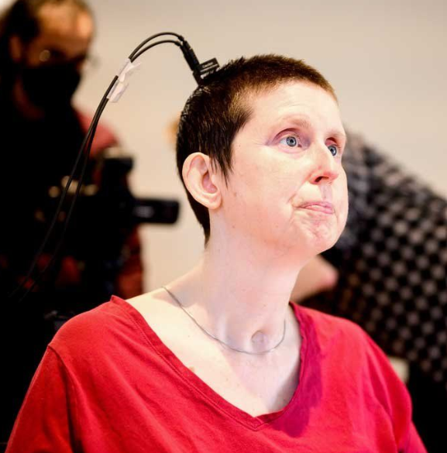
Ann’s STORY
She was a high school math teacher in Canada before her stroke in 2005 at age of 30. A wife and mother of two.
“Locked-in syndrome, or LIS, is just like it sounds,” she wrote. “You’re fully cognizant, you have full sensation, all five senses work, but you are locked inside a body where no muscles work. I learned to breathe on my own again, I now have full neck movement, my laugh returned, I can cry and read and over the years my smile has returned, and I am able to wink and say a few words.”

Slide 16

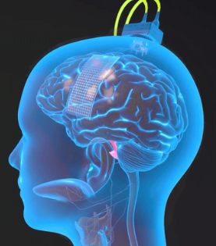
Edward Chang, MD, chair of neurological surgery at UCSF.
To do this, the team implanted a paper-thin rectangle of 253 electrodes onto the surface of her brain over areas they previously discovered were critical for speech.
The electrodes intercepted the brain signals that, if not for the stroke, would have gone to muscles in Ann’s lips, tongue, jaw and larynx, as well as her face. A cable, plugged into a port fixed to Ann’s head, connected the electrodes to a bank of computers.

Slide 17

To synthesize Ann’s speech, the team devised an algorithm for synthesizing speech, which they personalized to sound like her voice before the injury by using a recording of Ann speaking at her wedding.
“My brain feels funny when it hears my synthesized voice,” she wrote in answer to a question. “It’s like hearing an old friend.”
https://www.youtube.com/watch?v=iTZ2N-HJbwA

Slide 18

CONCLUSION
Speech impairments can result in isolation, depression, frustration, sense of inadequacy, lack of self-esteem, and reduced quality of life.
AI may accelerate progress in serving people with complex communication needs, non-standard speech impairments, and multiple disabilities.
Innovative AI systems are a turning point for the production of unprecedented solutions addressing Speech, Language, and Communication Needs in people with speech impairment.

Slide 19
jhbj
REFERENCES
https://dphhs.mt.gov/schoolhealth/chronichealth/developmentaldisabilities/speechorlanguageimpairment#:~:text=Speech%20or%20language%20impairment%20means,affects%20a%20child's%20educational%20performance.
https://my.clevelandclinic.org/health/diseases/21937-speech-impediment
https://online.maryville.edu/blog/speech-impediment-guide/
https://www.staceylbuckltd.com/statistics-on-speech-language-disorders#:~:text=Approximately%2018.5%20million%20individuals%20have,%2C%20voice%2C%20or%20language%20disorder.
https://www.contemporarypediatrics.com/view/pediatric-speech-disorder-diagnoses-more-than-doubled-amid-covid-19-pandemic
https://www.forbes.com/sites/forbesbusinesscouncil/2023/06/16/empowering-individuals-with-disabilities-through-ai-technology/

Slide 20
jhbj
REFERENCES
https://blog.gitnux.com/speech-and-language-disorders-statistics/
https://www.media.mit.edu/projects/alterego/overview/
https://www.ucsf.edu/news/2023/08/425986/how-artificial-intelligence-gave-paralyzed-woman-her-voice-back
https://apps.apple.com/us/app/touchchat-hd-aac/id398860728
https://lingraphica.com/aac-devices/what-is-an-aac-device/#:~:text=An%20augmentative%20and%20alternative%20communication,device%20or%20simply%20communication%20device.
https://www.tandfonline.com/doi/full/10.1080/17518423.2021.1903603
https://www.researchgate.net/publication/345598792_Artificial_Intelligence_for_Severe_Speech_Impairment_Innovative_approaches_to_AAC_and_Communication

Slide 21


THANK YOU

